Slide 1

Why coding
Present by: 甘祐銓

Slide 2

WHY WE NEED CODING
NUMERICAL SOLUTION
EASIER TO DO RESEARCH

Slide 3
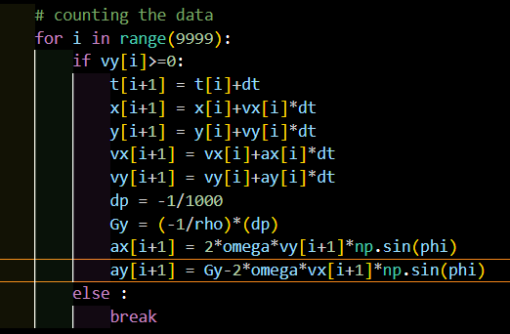
MY OWN EXPIRENCE
ESSENTIAL FOR REASERCH
SAVE MY GRADE

Slide 4
THANK FOR LISTENING

